Slide 1
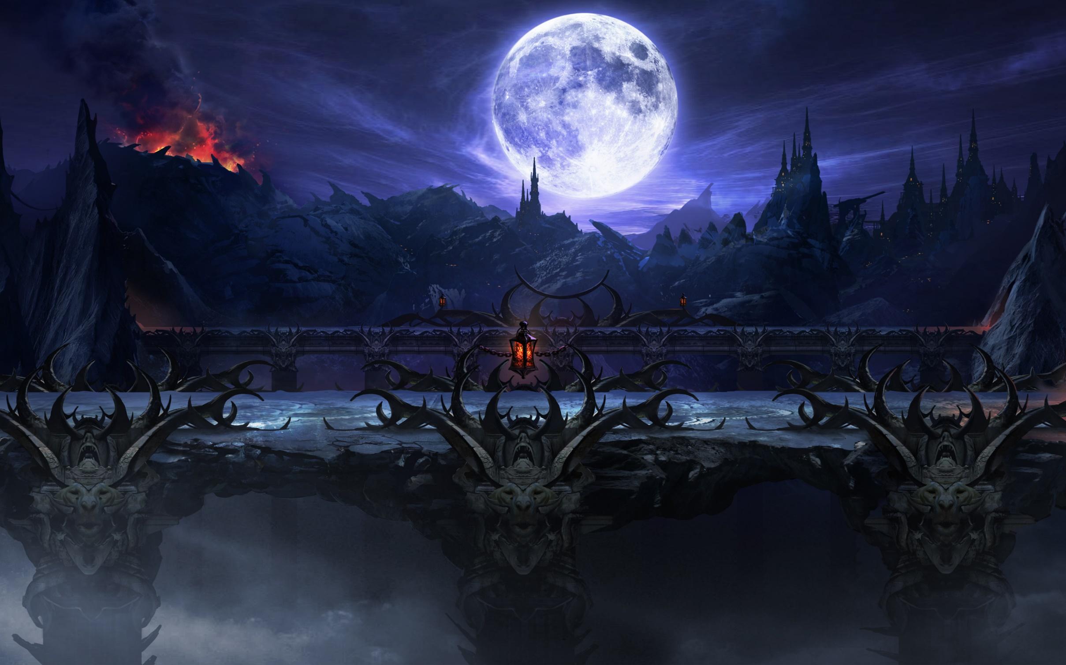

Mortal Kombat X game review by Joseph Tierney

Slide 2
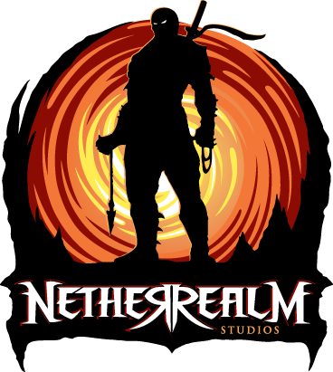
Overview
Developed by NetherRealm Studios
Released on Playstation 4, Xbox One and PC
Game costs €75
Special edition has all extras included, same price

Slide 3
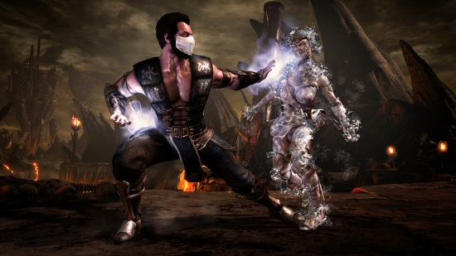
Game Overview
Mortal Kombat X is the best game in the franchise
Visually stunning
Gameplay is the best yet
Sounds are fantastic

Slide 4
Single Player Overview
Story takes place 25 years after MK9
Follows the wars between the different Realms
Player has to stop Shinnok
12 playable characters (Scorpion, Sub-Zero etc.)
Easy to come to grips with the controls (4 button inputs)
Can see combos on the pause menu

Slide 5
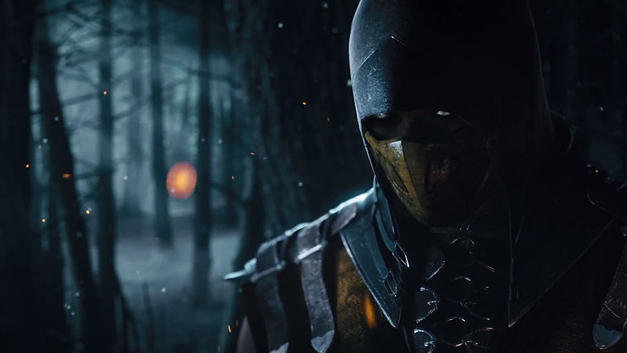
Online Overview
Difficulty based on your skill level and opponents
Multiple game modes to suit everyone
Really fun against friends!
Controls are a lot harder to master Online
Combos not easily connected (skill level)

Slide 6
Recap and Rating
PROS
Stunning graphics
Brilliant “popcorn munching, bone crunching” story mode
Crammed with long-term hooks, online and offline
Great character roster with cool variations
CONS
Fighting can feel oddly detached
Have to pay for extra fighters (Alien, Predator, Jason, Leatherface)
8/10

Slide 7
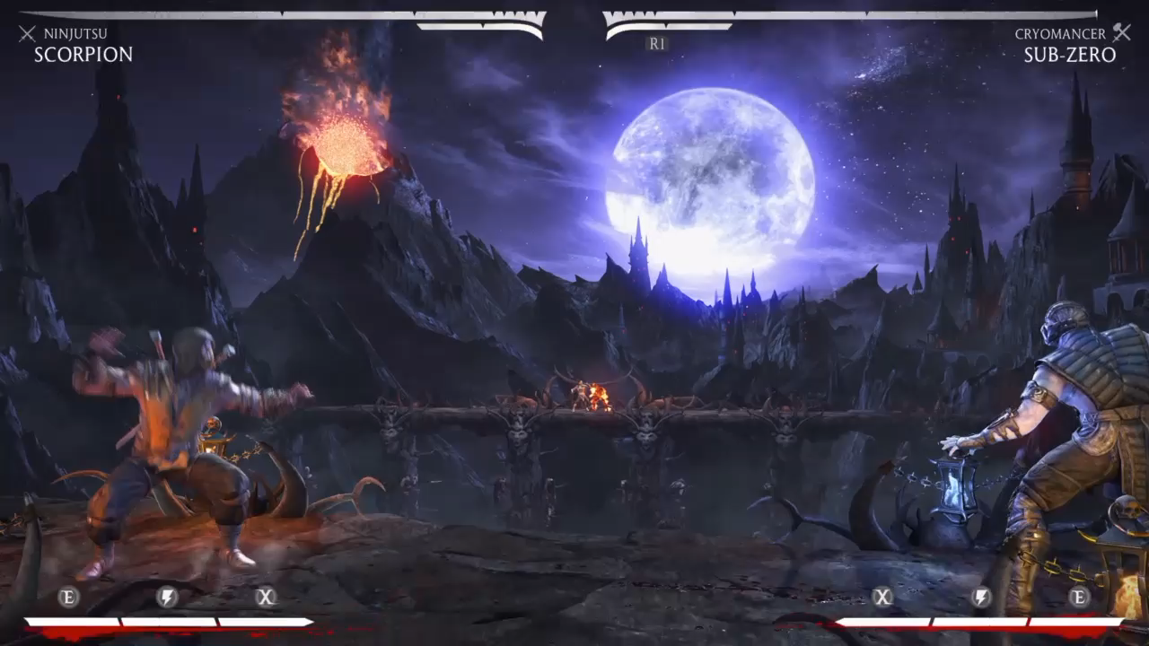
Sound and Graphic examples (GRAPHIC CONTENT) https://www.youtube.com/watch?v=wq0Cn5YD6g8
WARNING: Graphic Content
Notes:
*If video doesn’t play: https://www.youtube.com/watch?v=wq0Cn5YD6g8

Slide 8
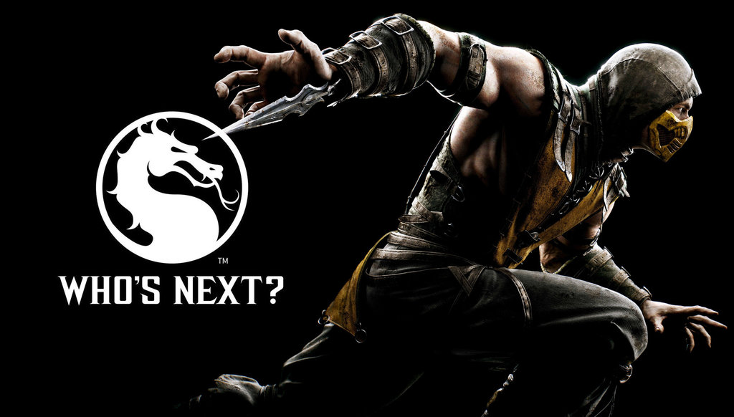
Any Questions?

